Slide 1
BEEE Unit 3
CONTENTS
1. Single phase transformer ( no numericals) – Working principle, types
2. Definitions-transformation ratio ,actual (practical) and ideal transformer .
3. Transformer losses, efficiency , applications of transformer.
FE-AIML Dr. Nirmala K

Slide 2
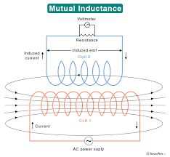

Slide 3
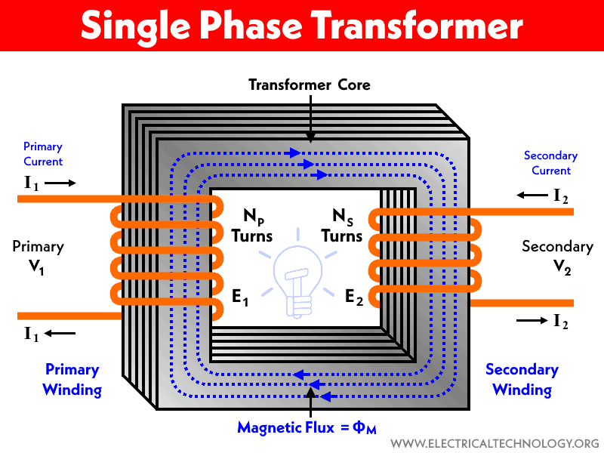
Transformer/single phase transformer
A single phase transformer is a static device that is used to change the voltage of alternating current from one value to another without changing the frequency. It transfers power from in one circuit to other without change in frequency.
It consists of a primary winding connected to the ac source of supply and a secondary winding to provide electric power to the load. The two windings are wound around a common magnetic core made of laminated silicon steel sheets which provides a low reluctance path for the magnetic flux. Single phase transformers convert the alternating voltage from one circuit to another without any direct electrical connection(isolation) between the two circuits.
Principle- Faraday's Law of Electromagnetic Induction-
Faraday's law states that an electromotive force (EMF) is induced in any closed circuit when there is a change in the magnetic flux through the circuit. This electromagnetic induction effect is the basis for the working of single phase transformers. When an alternating current flows through the primary winding, it produces an alternating magnetic flux around the core. According to Faraday's law, this changing flux induces an EMF in the secondary winding, by mutual induction.

Slide 4
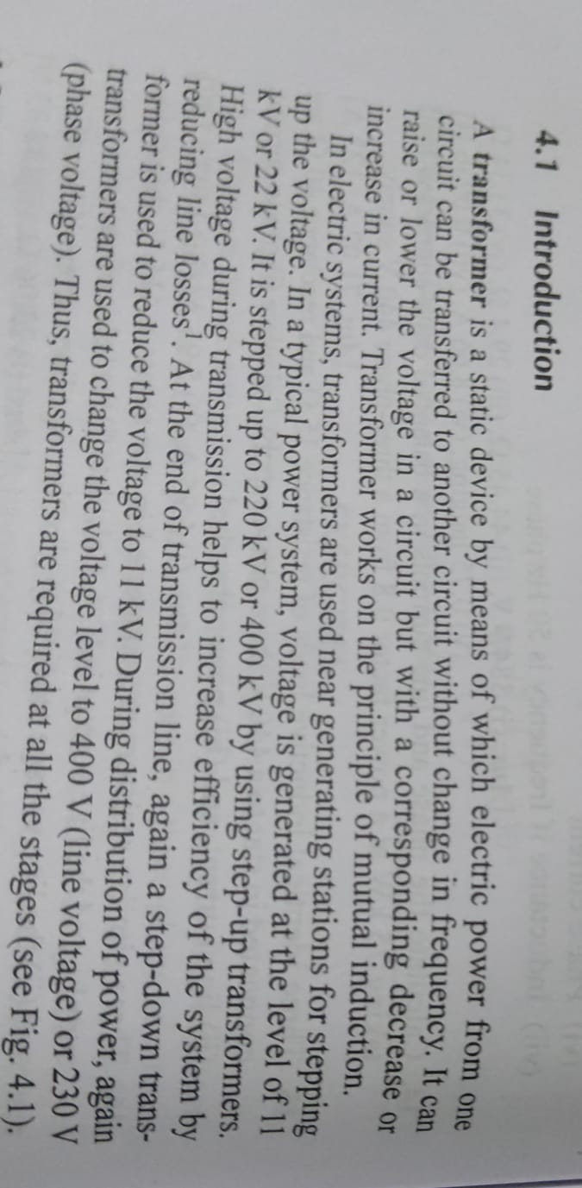
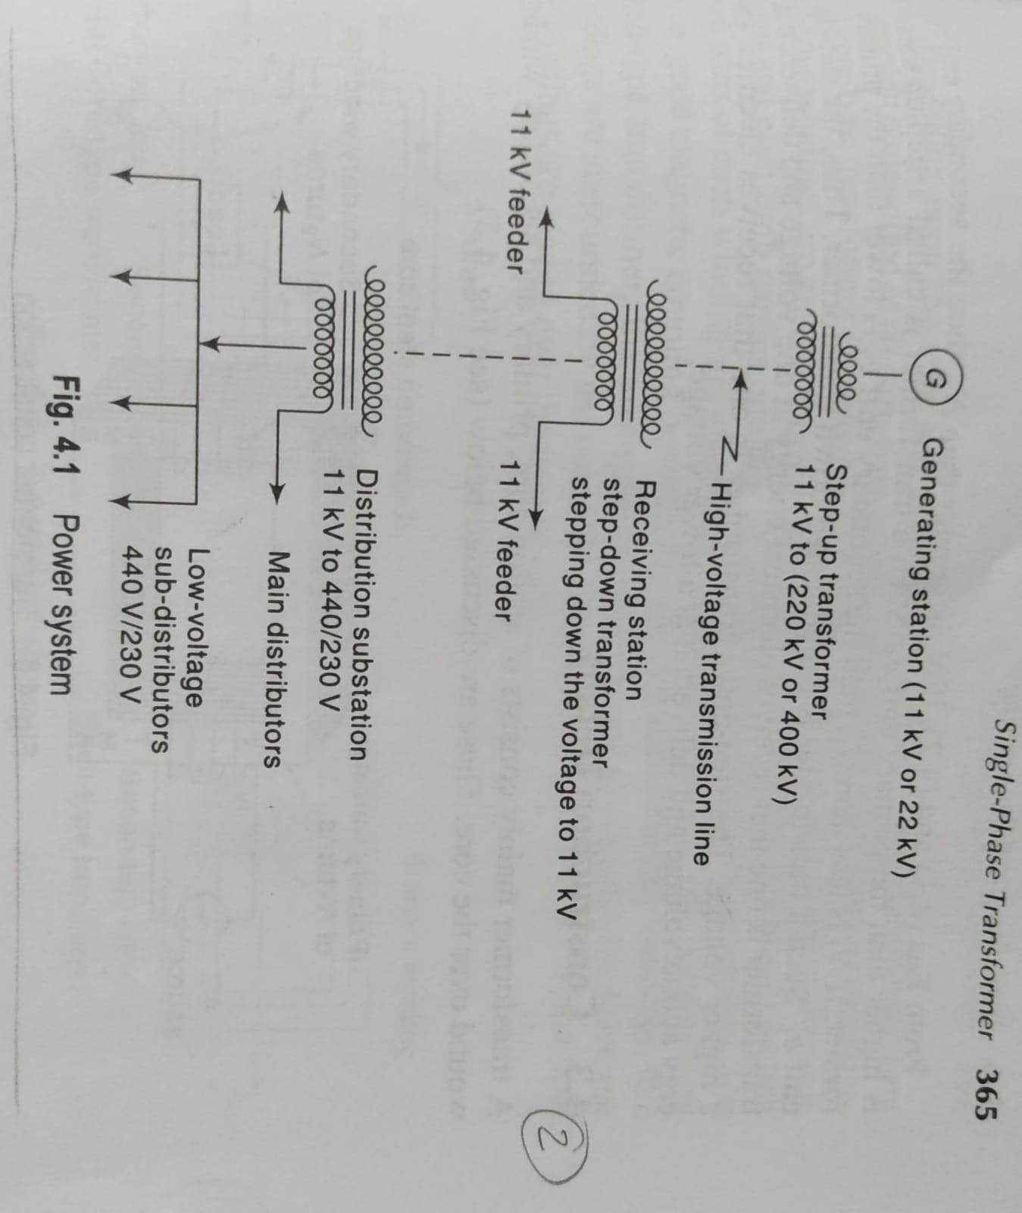
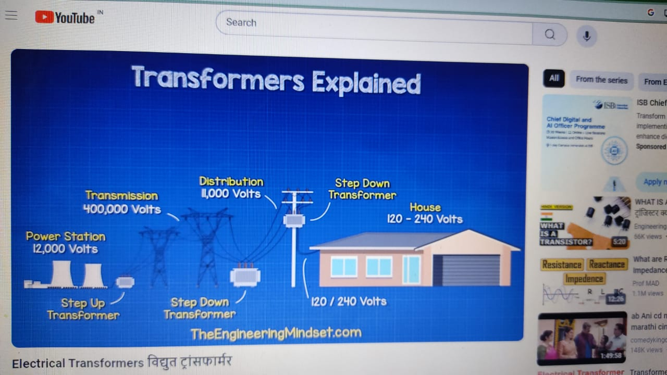

Slide 5
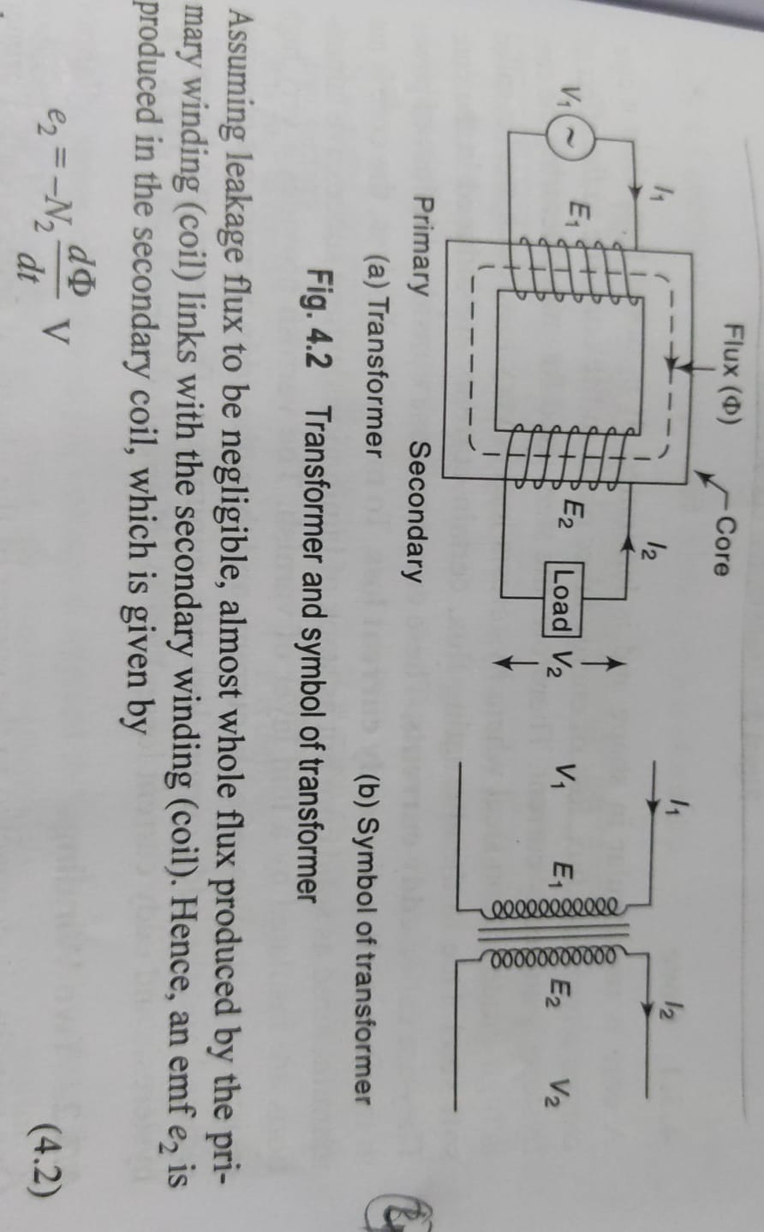
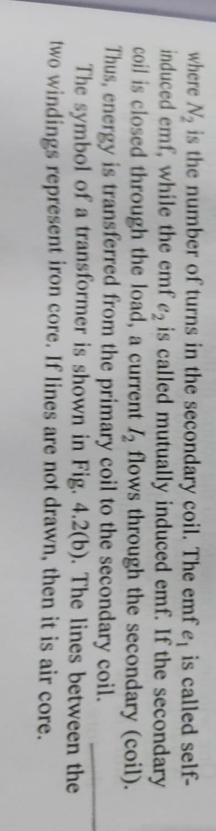

Slide 6
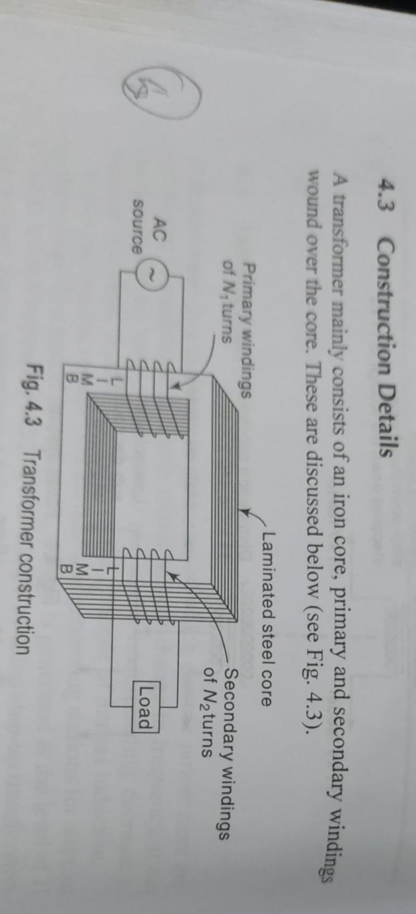
Construction of Single Phase Transformer
A single phase transformer is a high-efficiency piece of electrical equipment, and its losses are very low because there isn’t any mechanical friction involved in its operation.
Transformers are used in almost all electrical systems from low voltage up to the highest voltage level. It operates only with alternating current (AC) because direct current (DC) does not create any electromagnetic induction.
The key components of a single phase transformer are:
Core: It is made up of silicon steel laminations to reduce eddy current losses. The core provides a low reluctance path for the magnetic flux.
Primary Winding:It is connected to the source of alternating supply. The number of turns in the primary winding is kept as minimum as possible to reduce copper losses.
Secondary Winding:It is connected to the load. The number of turns is adjusted to get the required output voltage value from the induced EMF.

Slide 7

Working Principle Of Single Phase Transformer
As an alternating current flows through the primary winding, it produces an alternating magnetic flux φ in the core. According to Faraday's law of induction, this changing flux induces an EMF (ε) in the secondary winding given by E = -N dφ/dt.
The induced EMF causes current to flow in the closed secondary circuit to power the load. The transformer works on the principle of mutual inductance between the two windings.
EMF Equation Of A Single Phase Transformer
The induced EMF (E) in any winding having (N) number of turns is given by:
Where,
f → frequency Hz
N → number of turns of winding
Φ → Flux density in Wb
N1 is the number of turns in the primary winding
N2 is the number of turns in the secondary winding
The primary EMF is given as-
We know that ϕ is due to AC supply ϕ = ϕm Sin(wt)

Slide 8
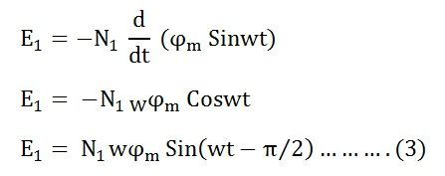
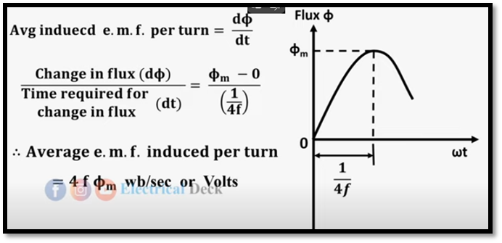





So, the induced emf Will lag 90 degrees by flux.
Maximum valve of emf
But w = 2πf
Root mean square RMS value is
Putting the value of E1max in equation (6) we get
Putting the value of π = 3.14 in the equation (7) we will get the value of E₁ as,

Slide 9
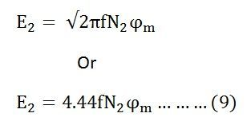
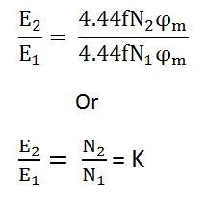
Similarly
Now, equating the equation (8) and (9) we get
The above equation is called the turn ratio where K is known as the transformation ratio.

Slide 10
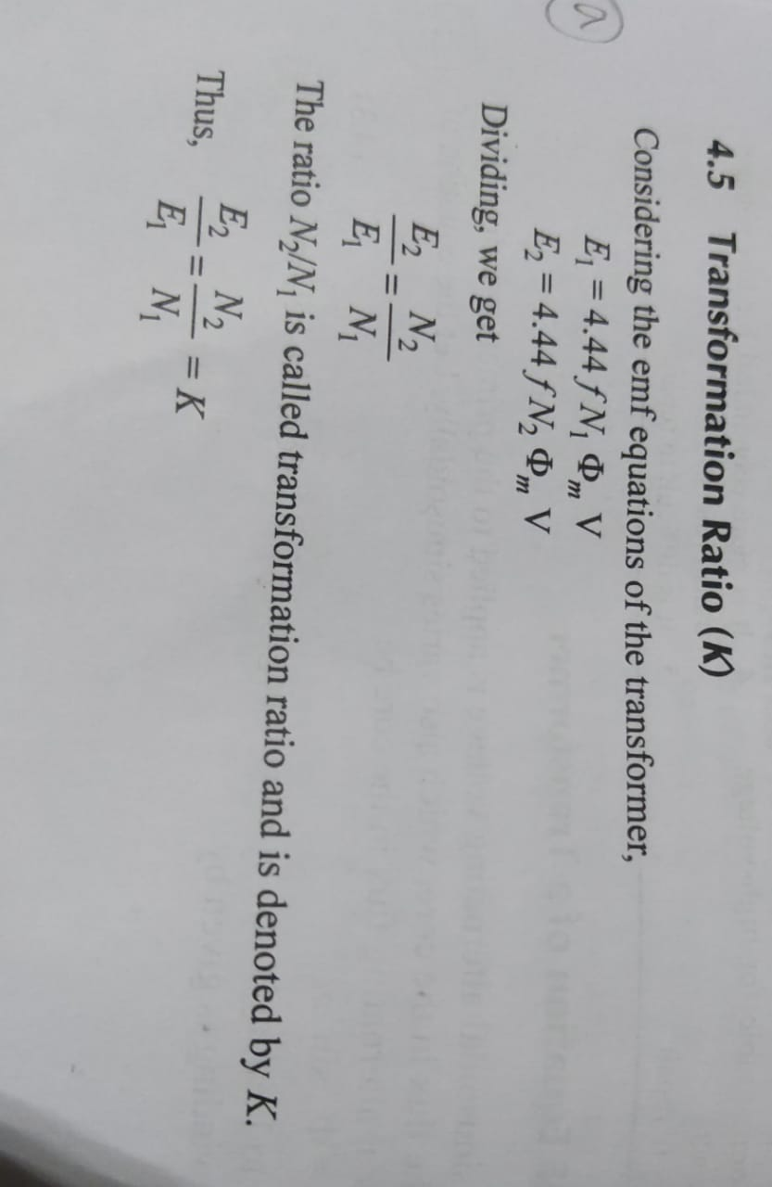
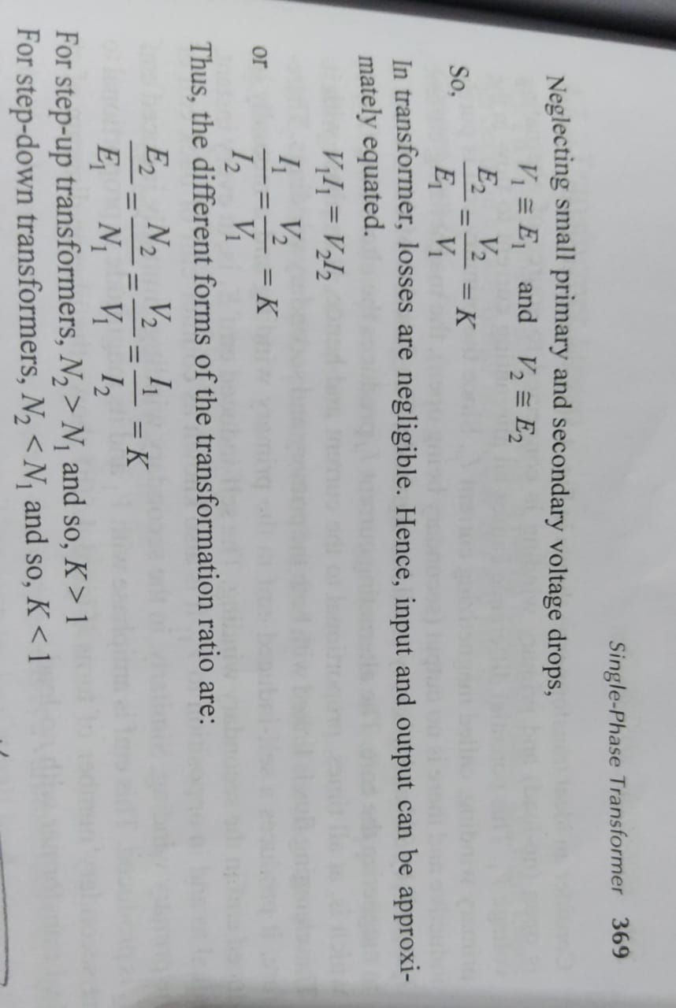
Transformation ratio

Slide 11
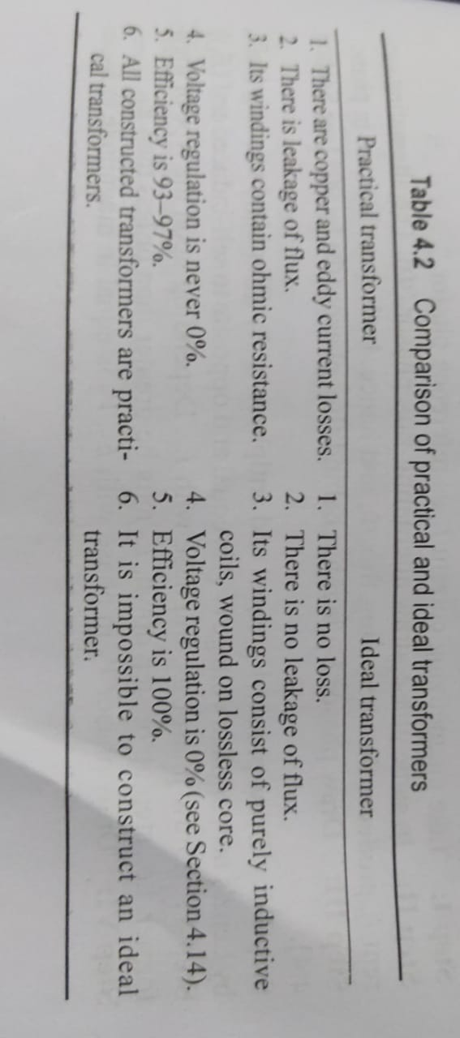
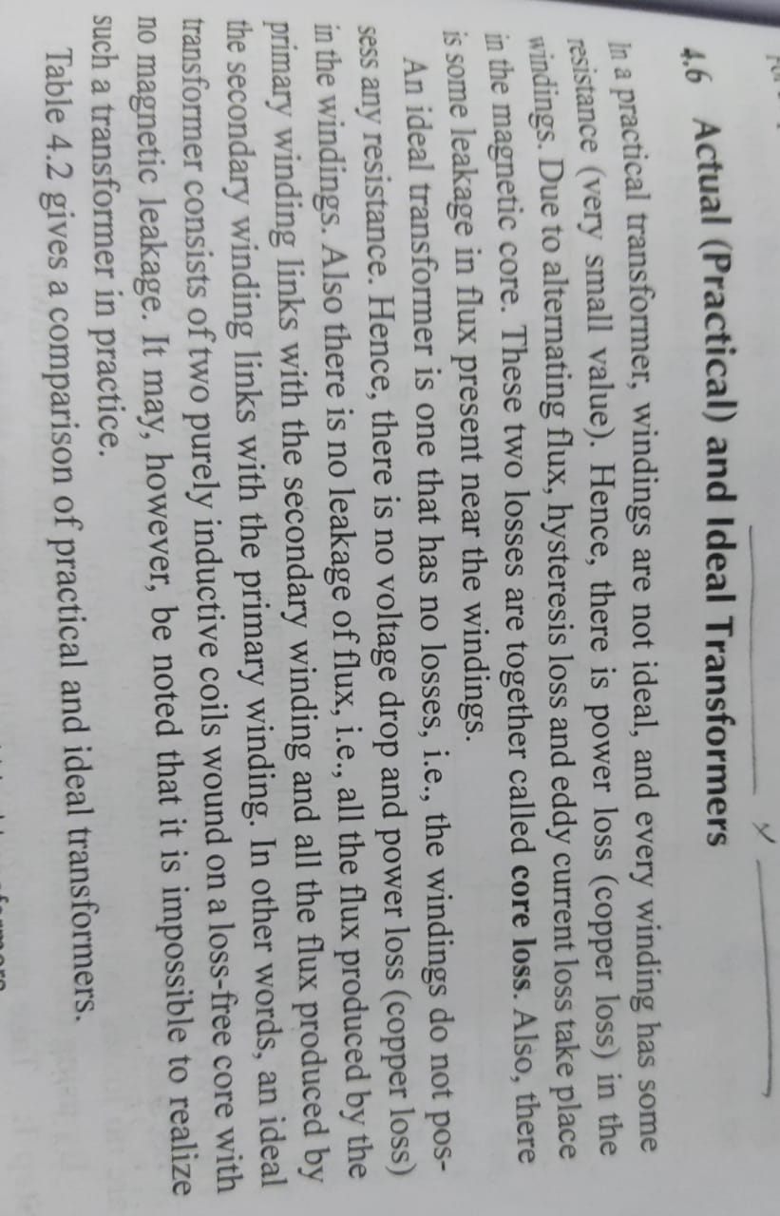
Ideal and practical transformer

Slide 12
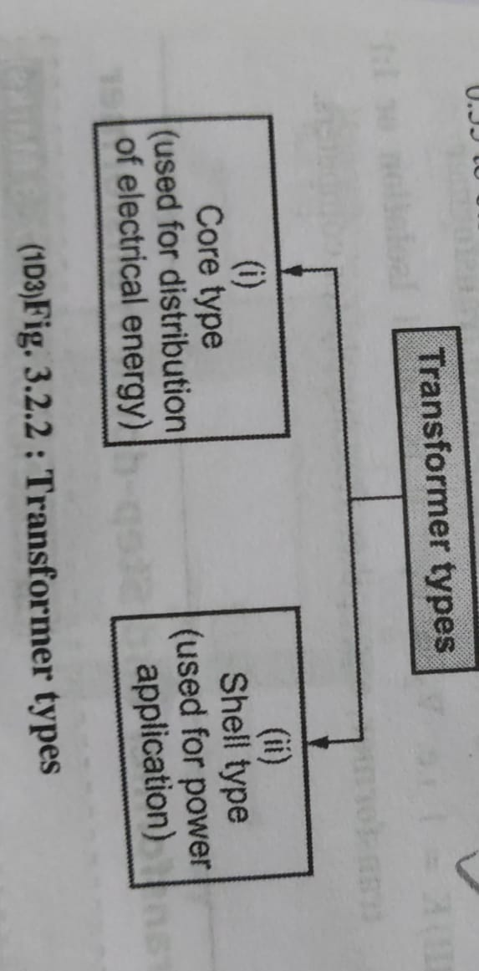
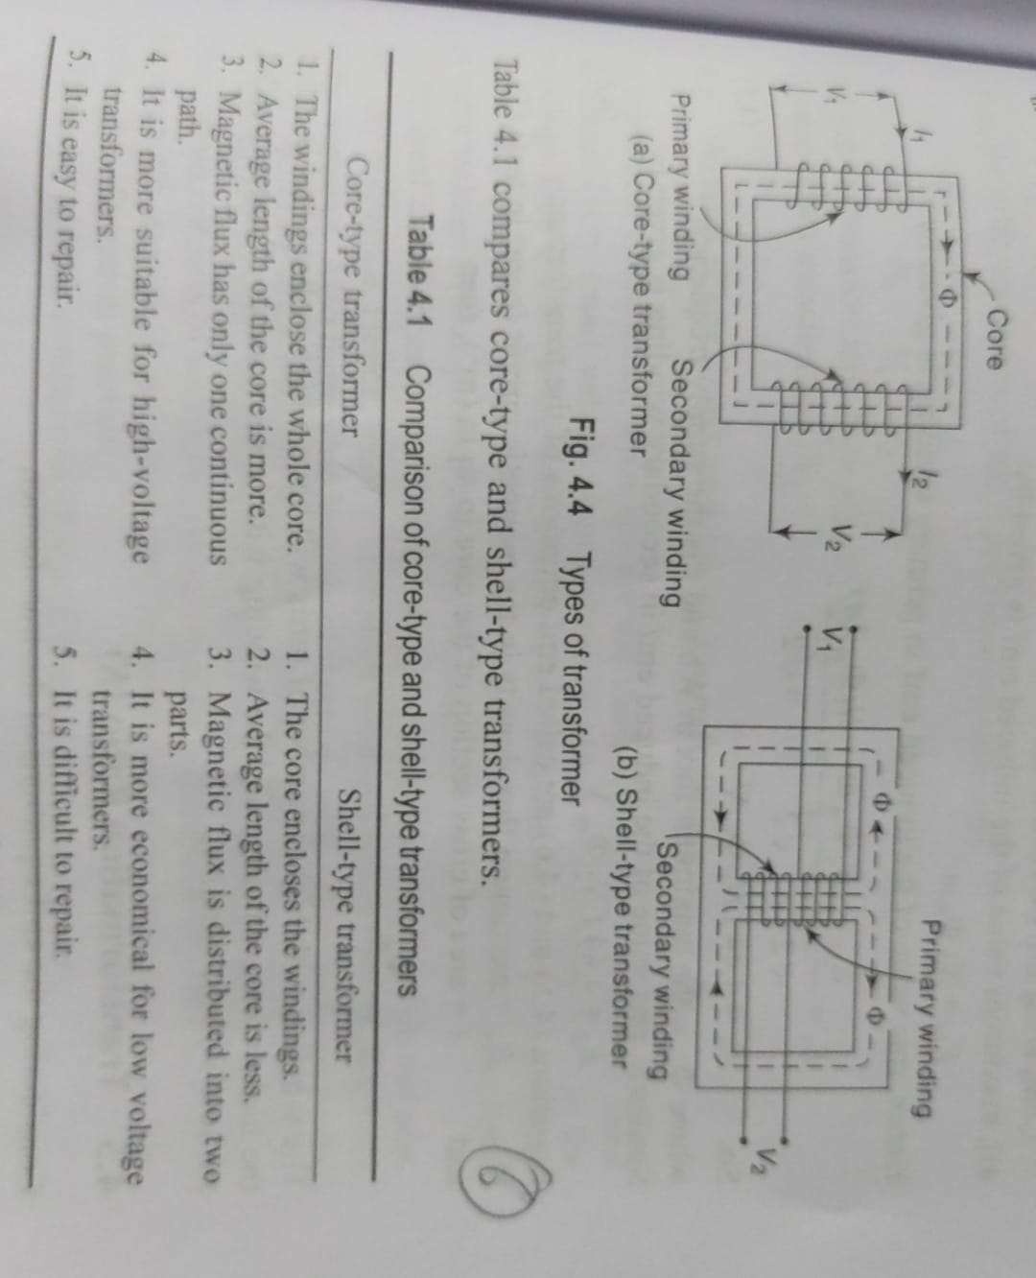
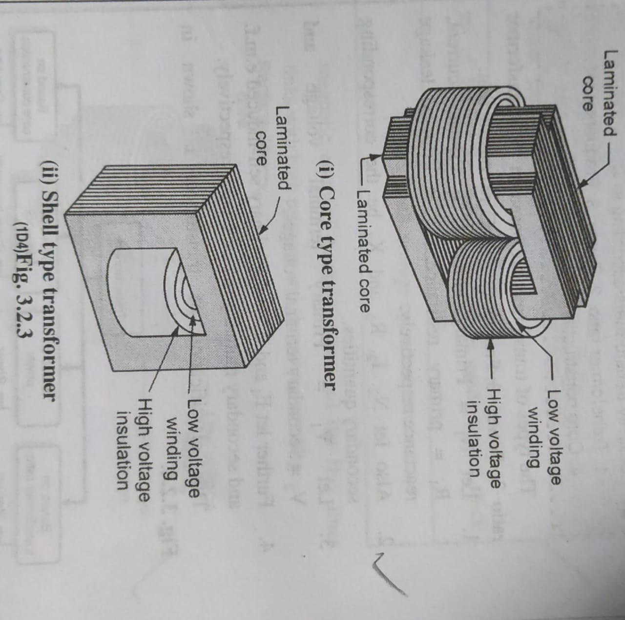

Slide 13
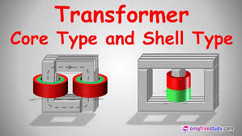

Slide 14
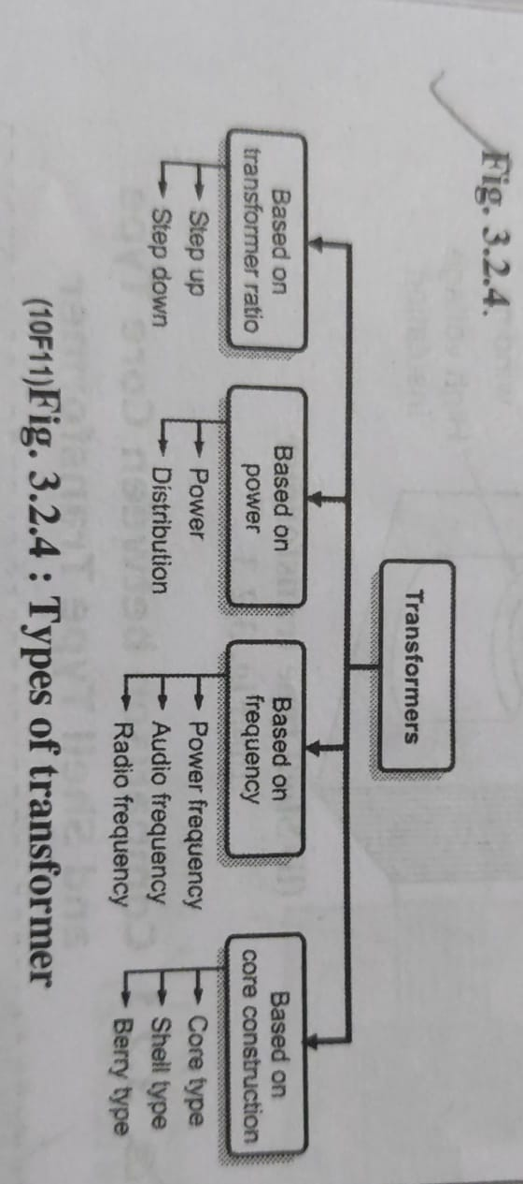
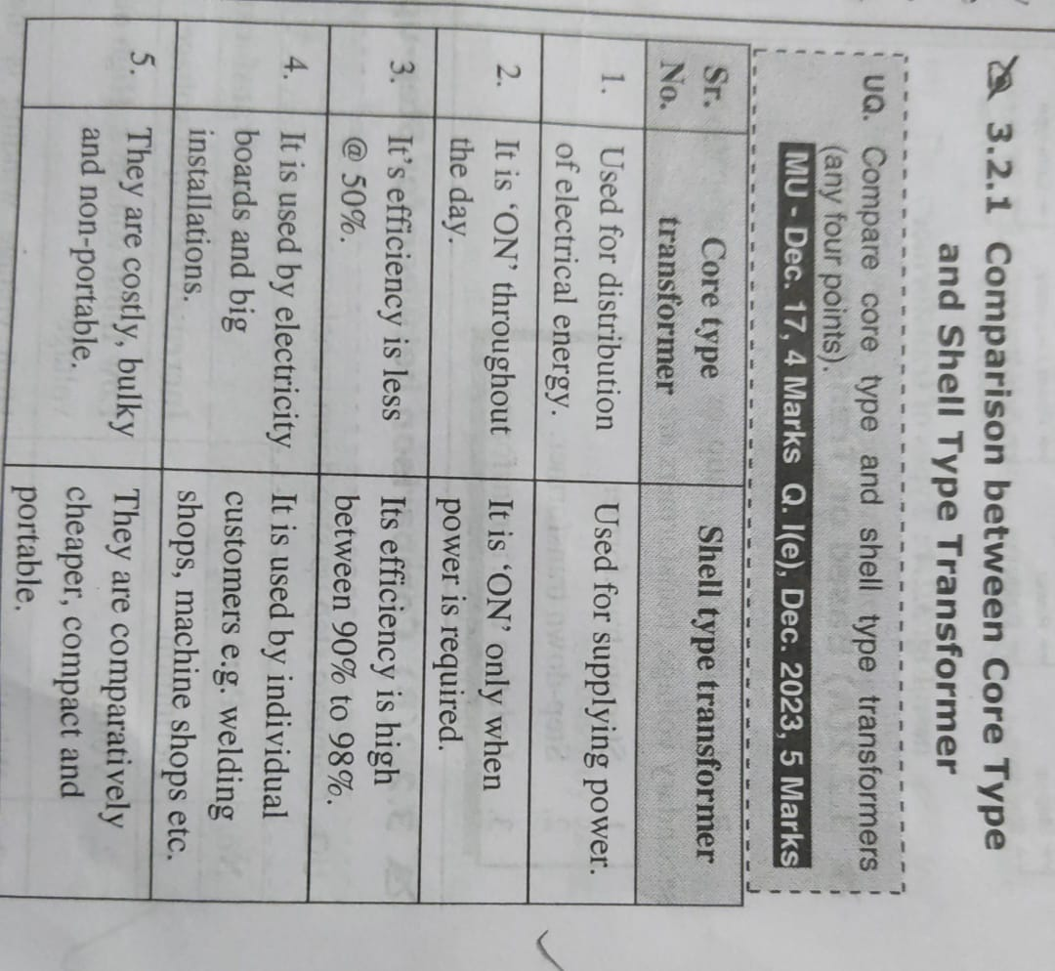

Slide 15
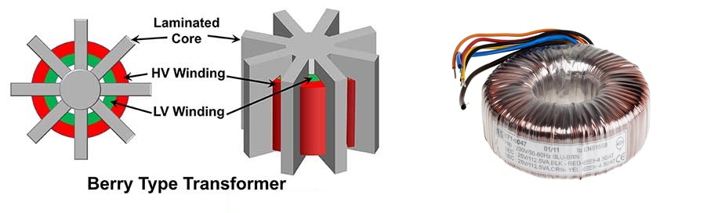
Berry type transformer
Berry transformer /toroidal transformer, which is a large type of electronic transformer and has been widely used in home appliances and other electronic equipment with high technical requirements. Its main use is as a power transformer and an isolation transformer.
Widely used in computers, medical equipment, telecommunications, instruments and lighting.

Slide 16
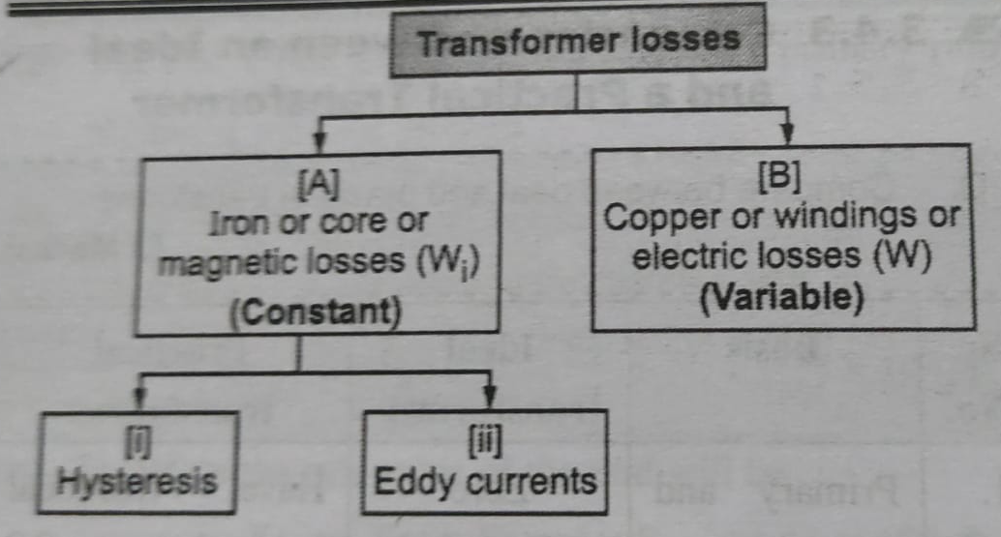
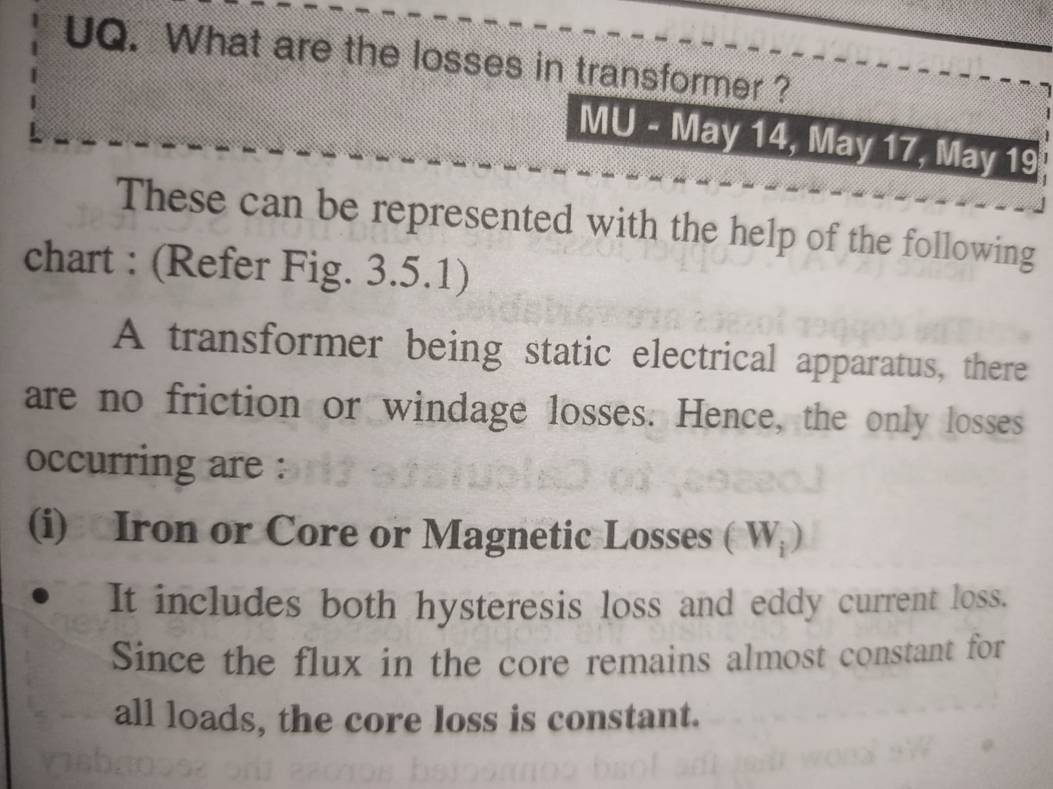
i

Slide 17
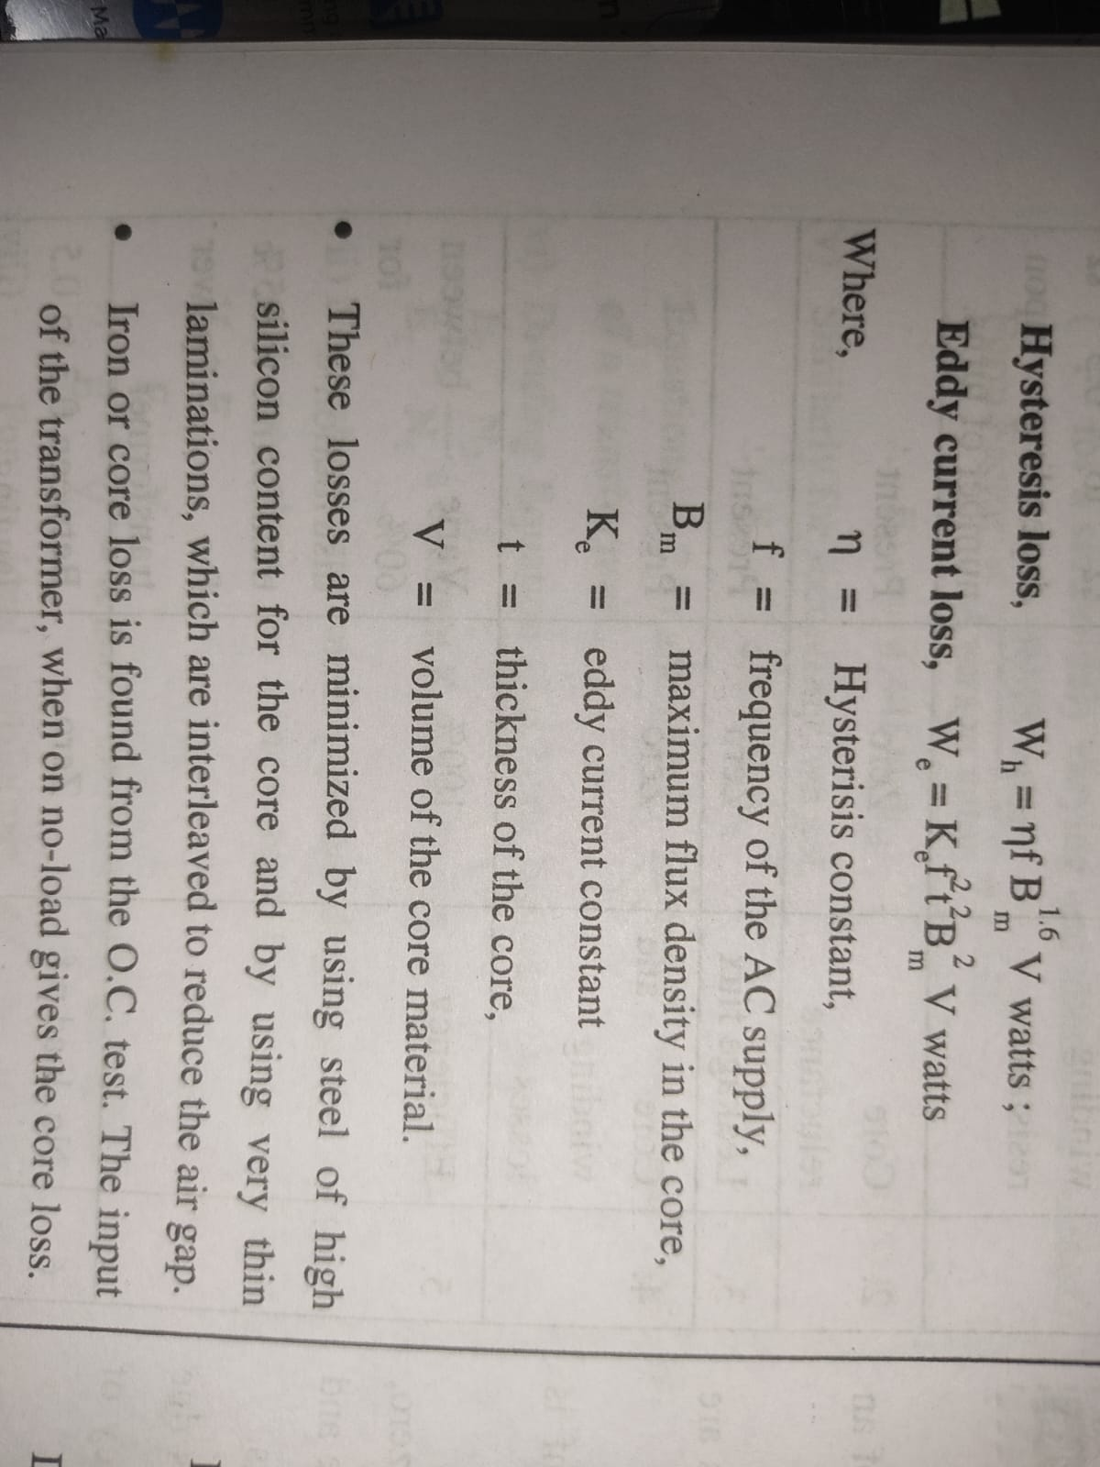
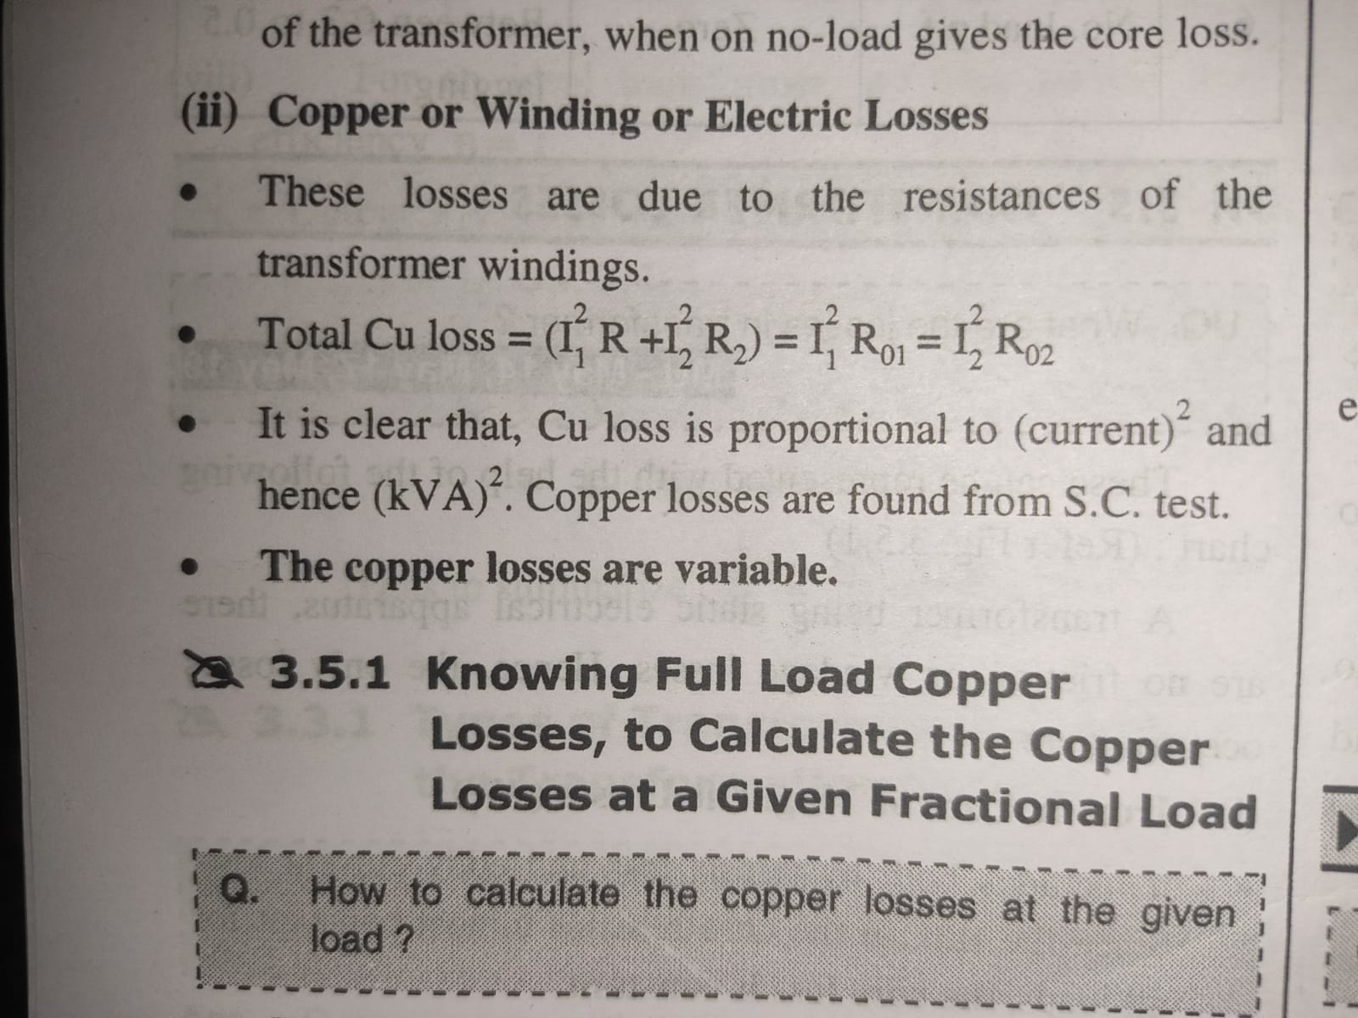

Slide 18
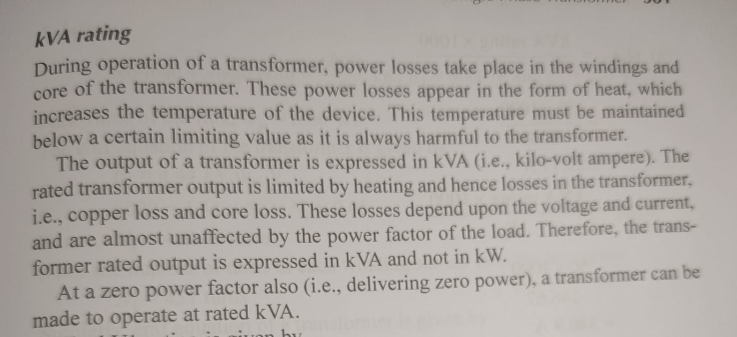
Transformer ratings in KVA (4 -6 mks)

Slide 19
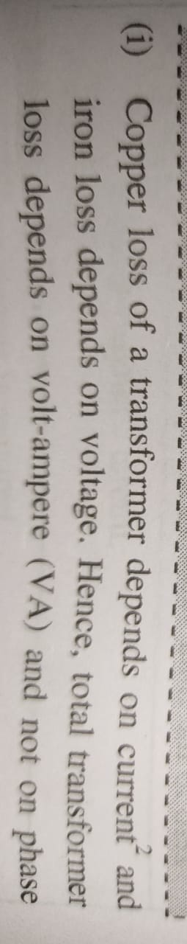
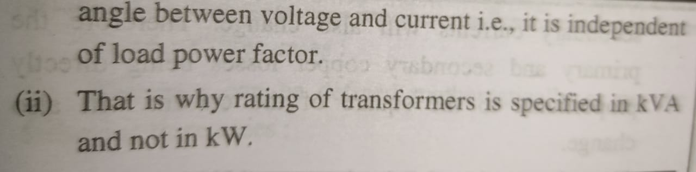
Transformer ratings in KVA ( 2 mks)

Slide 20
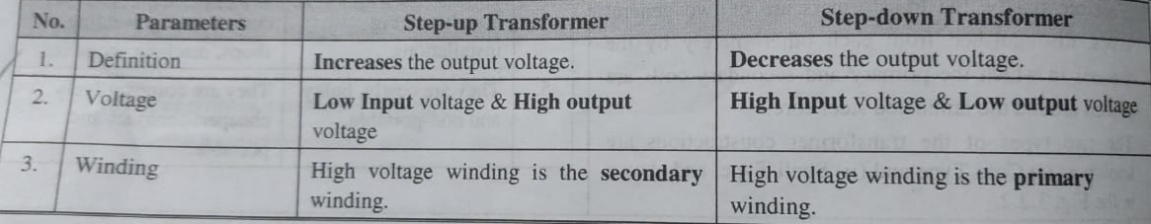
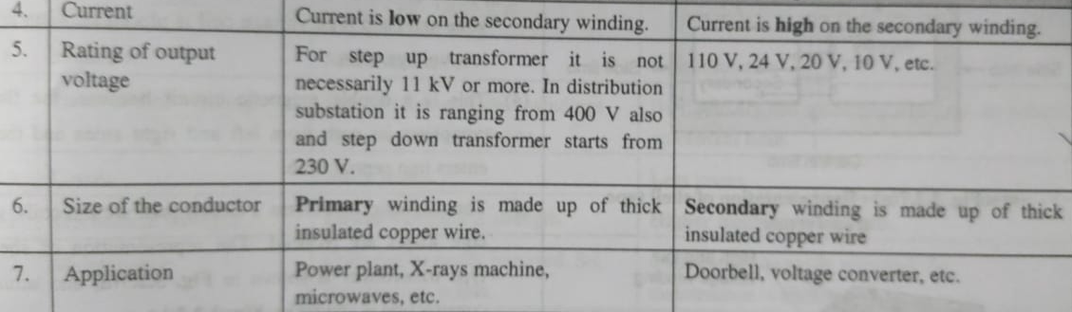
Compare step up and step down transformer

Slide 21
Efficiency of transformer
The ratio of output power to input power is known as transformer efficiency. It measures how effectively a transformer converts AC electrical energy from one form to another. Transformer efficiency is measured in terms of percentages, it ranges from 97% to 99%. The transformer has no moving parts so the losses due to friction and windage are absent therefore its efficiency is very high. The transformer efficiency is represented by η.
% Efficiency,η = Output Power / Input Power *100
We can determined the efficiency of a transformer by directly loading the transformer and measuring the input power and output power (but this method is not preferred as it may give wrong results)
So ,
In practice, we use open-circuit and short-circuit tests to find out the transformer efficiency.
For a practical transformer, the input power is given by-

Slide 22
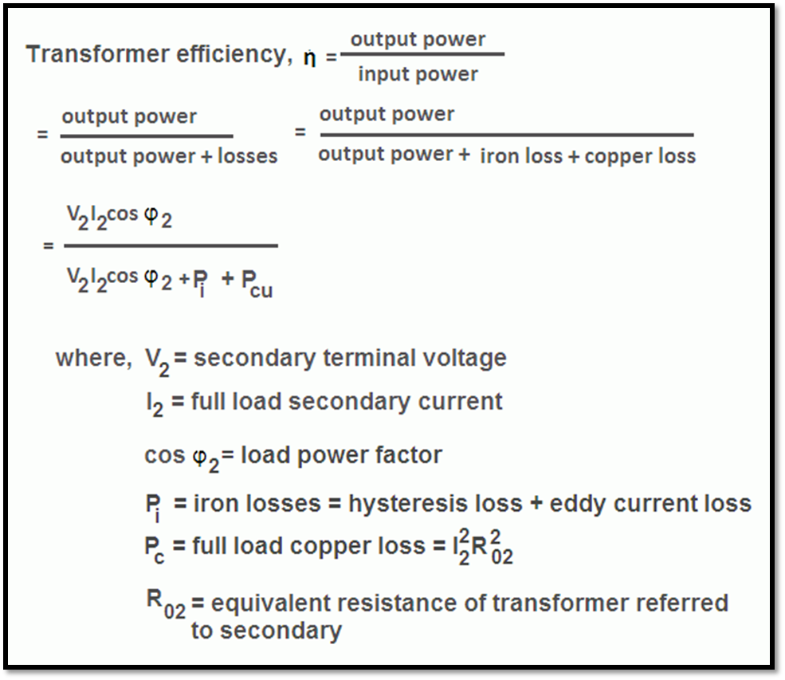
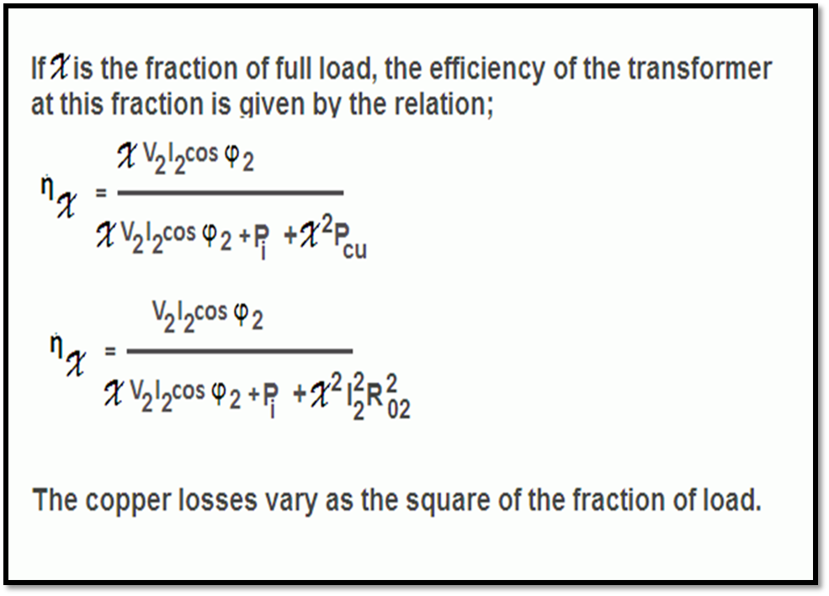
Output power= VA * PF = V2*I2*COS ø .Also, the transformer efficiency at any load equal to x × full load. Where, x is the fraction of loading. It is because, the iron loss (Pi) is the constant loss and hence remains the same at all loads, while the copper loss is proportional to the square of the load current.

Slide 23
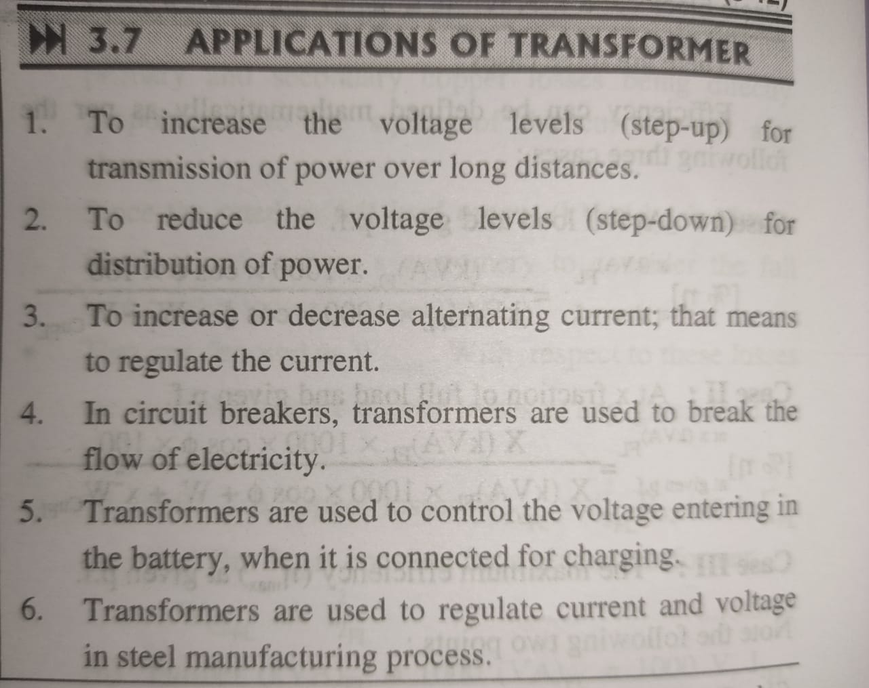
Applications of transformer-
7.A transformer also works as isolator , to isolate high voltage and low voltage circuits.
8. Used in battery charger/adaptor/ie voltage regulator circuits.

Slide 24
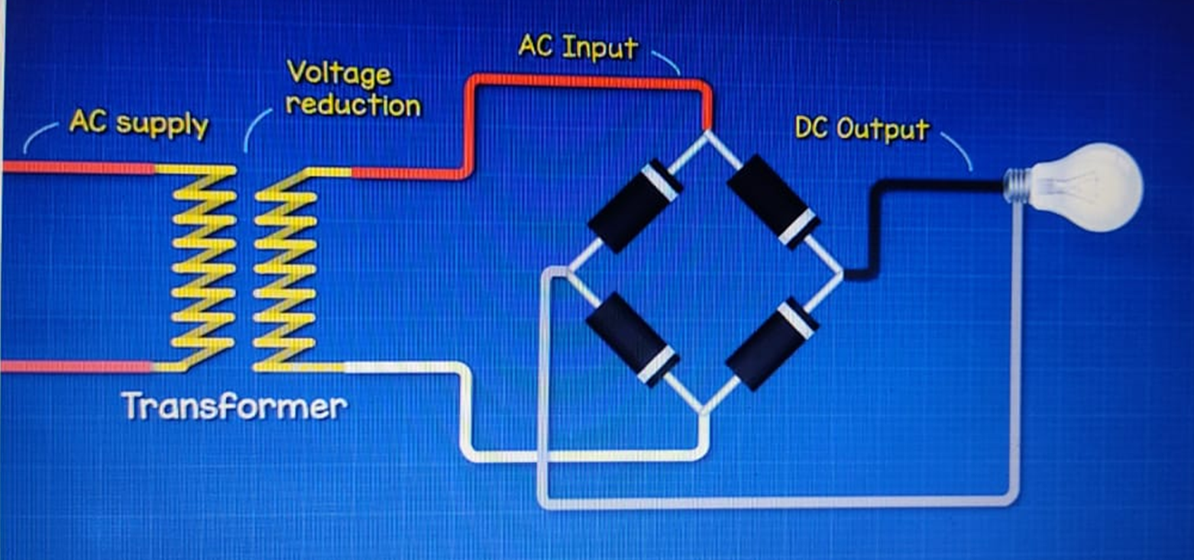
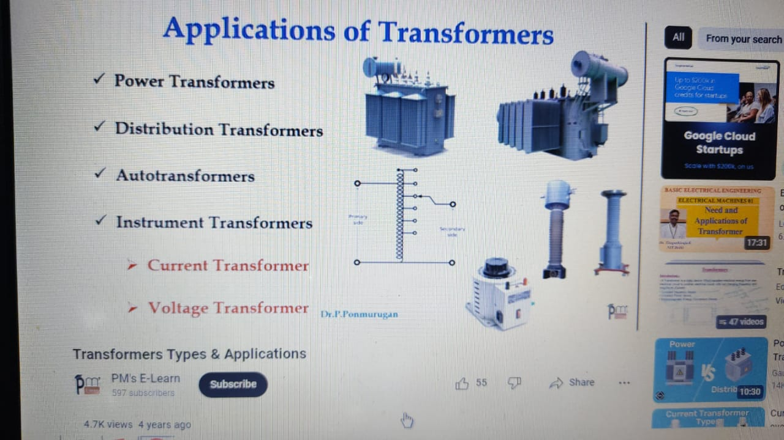
Application Example-
More types of transformers
Rectifier

Slide 25
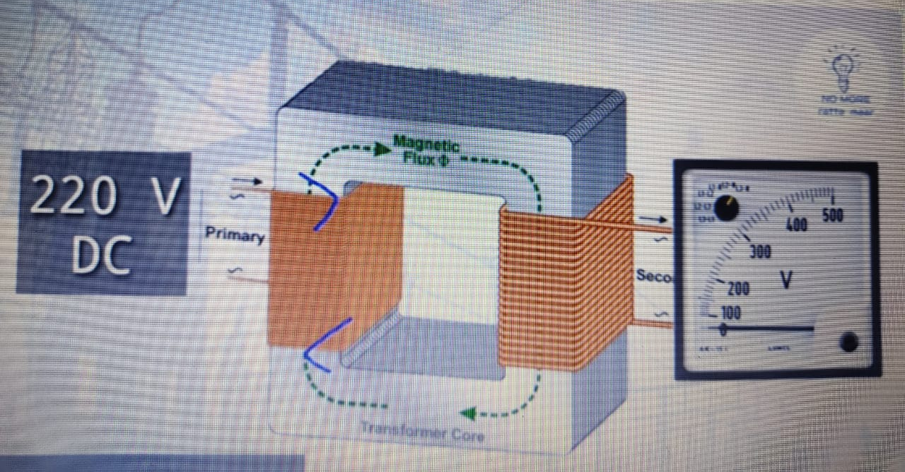
https://www.youtube.com/watch?v=QPMljGEruU4 https://www.youtube.com/watch?v=ZiTh8oLVpGs know more…………………..
Transformer connected to DC supply ?

Slide 26
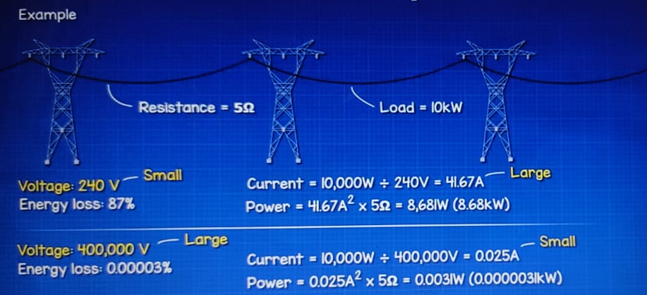
Transmission line , transmission is high voltage , why?

Slide 27
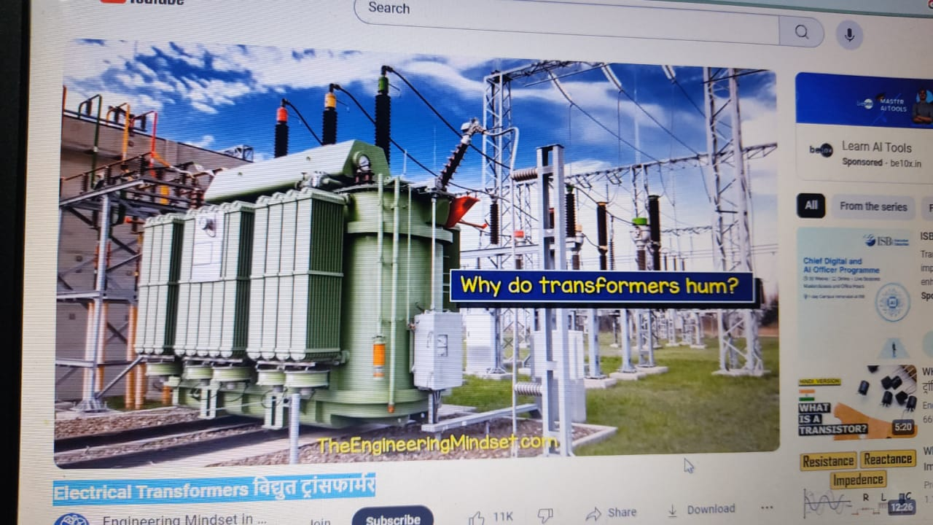
Why transformers produce humming noise?

Slide 28
Questions for assignment and practice
Assignment 4
( AY 2025-26)
Unit 3-Single Phase Transformer
Explain with neat sketch the working principle of single-phase transformer.
Derive for the EMF equation and hence transformation ratio for single phase transformer.
Derive for the efficiency of a single phase transformer.
Compare actual (practical) and ideal transformer (6 points).
Explain the various transformer losses.
‘Transformation ratio is in KVA and not KW’, Give reason.
List the applications of transformer with one example.
List the different types of transformers and explain any one with neat sketch.

